Slide 1
Candidate Exercise Sr. Actuarial Analyst – Actuarial Data
Eric Hang

Slide 2
Outline
Prompt Overview
Datasets 1-3
Exploratory Data Analysis
Data Cleaning and Adjustments
Clarifying Questions
Selecting an Exposure Base
Final Calculation of Ceded LC and Frequency
(Revised) Final Calculation of Ceded LC and Frequency
Conclusion

Slide 3
Prompt Overview
Reinsurance: Considering a $250k – 1.5M layer of Reinsurance Coverage
Covered Policies:
Policy 123 – Period 3 Losses up to $1M per occurrence, subject to deductible
Policy 456 – Period 2 & 3 Losses $1M XS $1M
Request: Calculate Incurred Loss Costs and Claim Frequency for the Ceded Layer at various maturities

Slide 4
Reinsurance
Clarifying Questions
What Coverage will the reinsurance apply to?
What Risk Segment (e.g. Eats, P2P, …) will the reinsurance apply to?
AY 2020-2021 will likely be anomalous due to COVID-19 lockdown impacts e.g.
Higher Eats than P2P usage
Lower Accident Frequency
What adjustments are being made to historical loss and exposure for the prospective Reinsurance Contract?

Slide 5
Dataset 1 – Policy 123 Losses
Exploratory Data Analysis: First Impressions
Initial Impressions:
Liability Loss dataset, censored at $1M limit
Each loss is evaluated multiple times
AY 2018 – 2021; includes COVID-19 period
Claims include P0, P1, and P3

Slide 6
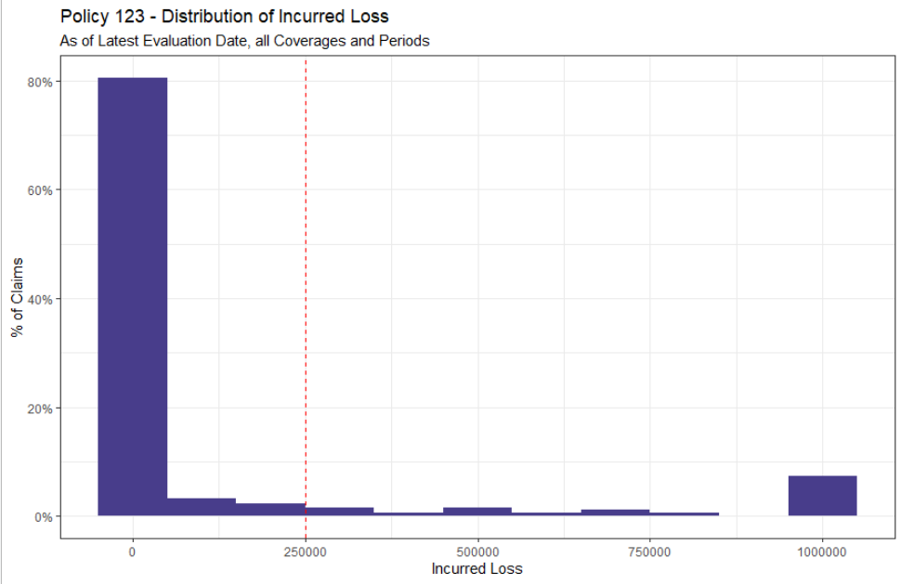
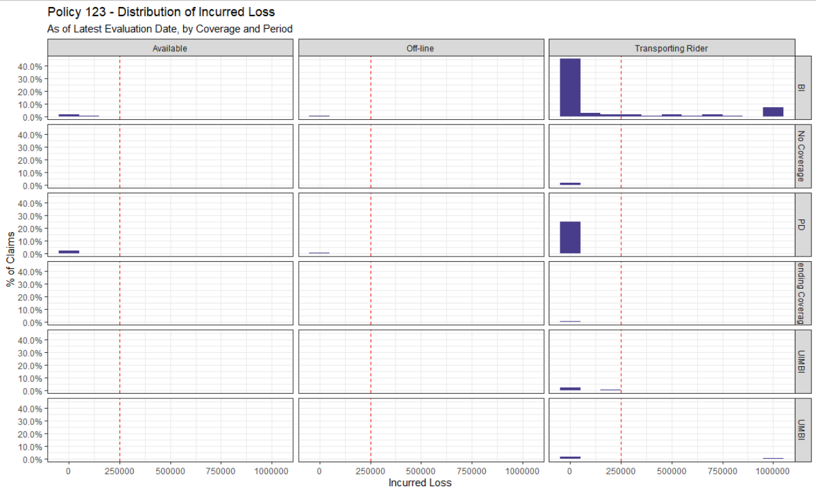
Dataset 1 – Policy 123 Losses
Exploratory Data Analysis: Incurred Losses
Approximately 10% of Losses exceed the reinsurance threshold of $250k
These losses are predominantly P3 BI Liability Losses
Notes:
Incurred Losses defined as Paid + Reserves
*Non-P3 Losses should NOT technically be included in Policy 123

Slide 7
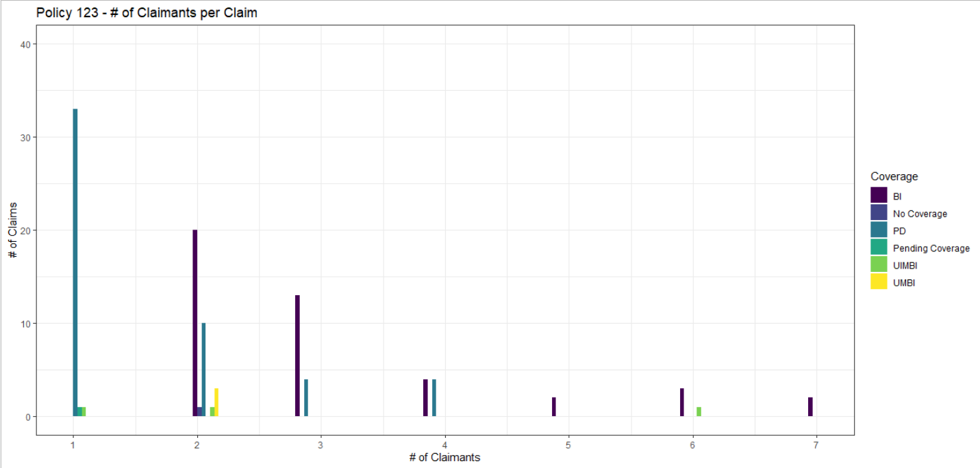
Dataset 1 – Policy 123 Losses
Exploratory Data Analysis: Claimants
Multi-claimants losses are most common for P3 BI Liability
The same loss event often triggers both BI + PDL coverages
(Both observations align with expectations)

Slide 8
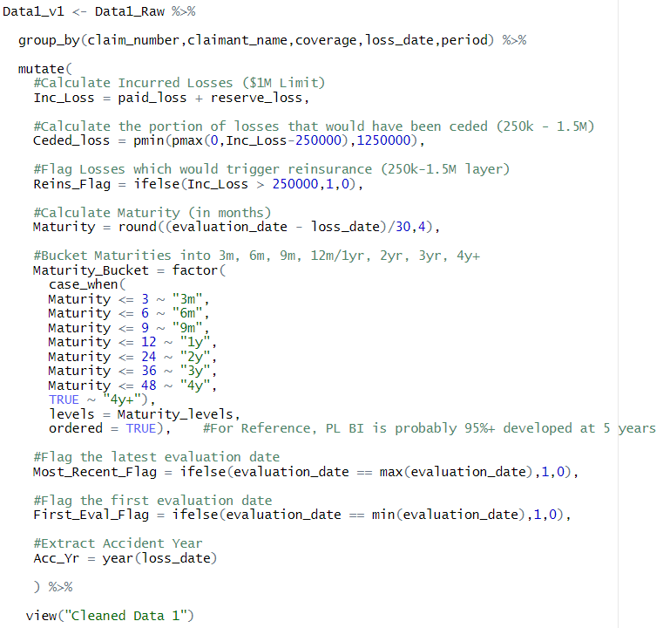
Dataset 1 – Policy 123 Losses
Data Cleaning and Adjustments
Notes:
Also noticed some minor data quality issues with claimant names, but unable to correct due to time constraints

Slide 9
Dataset 1 – Policy 123 Losses
Clarifying Questions
Policy 123 only covers Period 3 Losses – why are non-Period 3 Losses included in the dataset?
Are there any privacy/legal concerns with using a Claimant Name field?
What does the field “feature_identifier” represent? Why was this provided for Policy 123, but not for Policy 456 (dataset 2)?
BI Liability typically has a per-person as well as a per-accident/occurrence limit. Are there any applicable per-person limits to consider?
Presumably, the losses provided are after application of deductibles – is it possible to include deductible amounts in the data?
Does the field “reserve_loss” refer to case reserves, or total loss reserves (i.e. includes IBNR)? *Assumed Total Loss Reserves
Do losses include subrogation, if any? (e.g. from counterparty Medpay/PIP coverage)

Slide 10
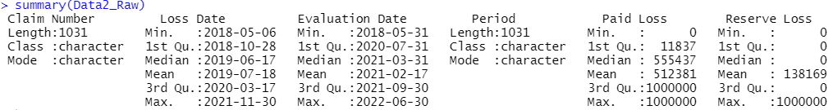
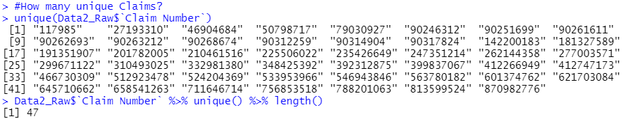
Dataset 2 – Policy 456 Losses
Exploratory Data Analysis: First Impressions
Initial Impressions:
$1M XS $1M Losses, censored at $1M limit
Each loss is evaluated multiple times
AY 2018 – 2021; includes COVID-19 period
Claims include P0-P3

Slide 11
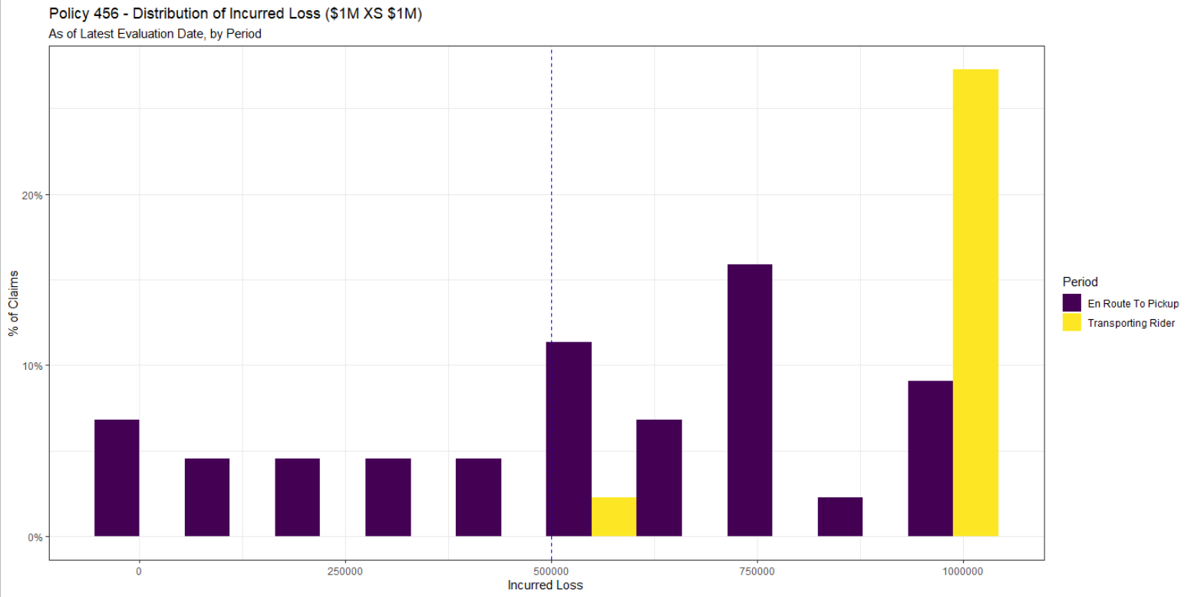
Dataset 2 – Policy 456 Losses
Exploratory Data Analysis: Incurred Losses
All P3 incurred losses in this dataset exceed the $1.5M reinsurance upper bound, as do most P2 incurred losses

Slide 12
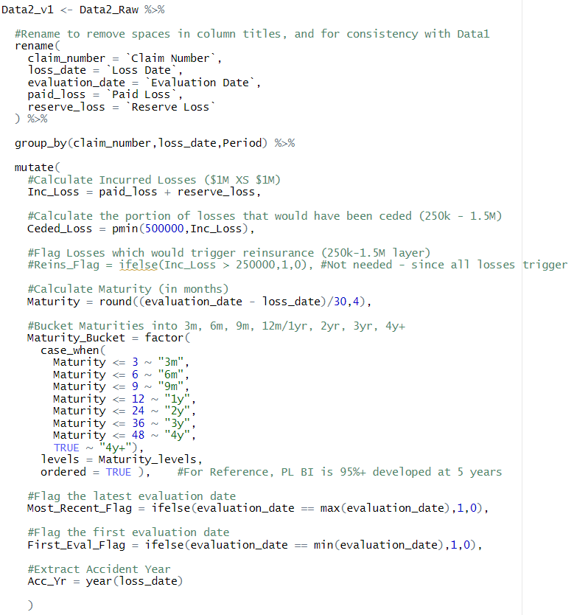
Dataset 2 – Policy 456 Losses
Data Cleaning and Adjustments

Slide 13
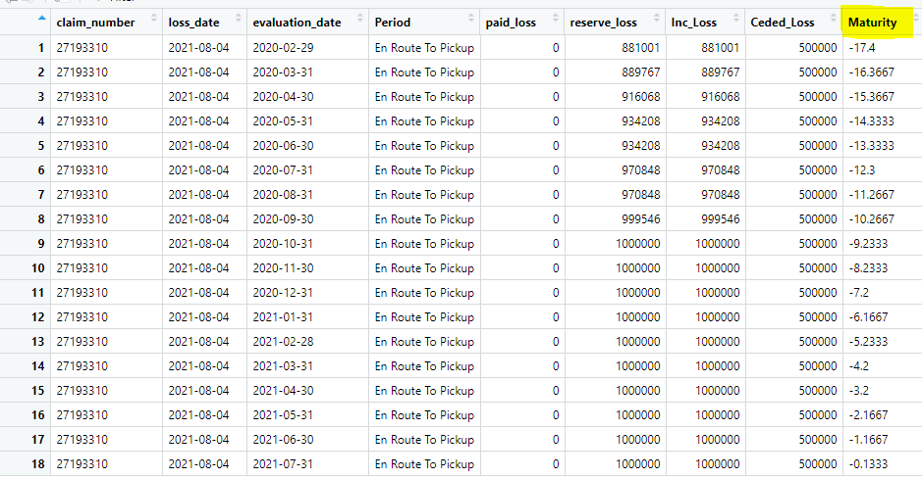
Dataset 2 – Policy 456 Losses
Data Cleaning and Adjustments – Negative Maturities
Observed Claim Number “27193310” where Evaluation Date < Loss Date, resulting in negative maturities

Slide 14
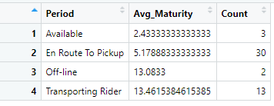
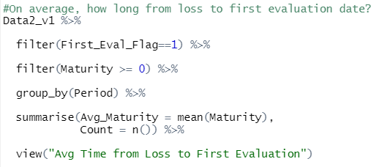
Dataset 2 – Policy 456 Losses
Data Cleaning and Adjustments – Negative Maturities
Due to the size of the claim ($1M) and its relevance for reinsurance purposes, decided to retain the data
While either Loss or Evaluation Dates could have been incorrect, it’s probably more likely that an incorrect loss date was entered, and then carried forward at each subsequent evaluation
Calculated the average time from loss date to first evaluation date; for Period 2 losses, the time is ~ 5 months
Imputed a corrected Loss Date based on the claim’s first evaluation date: 1/31/2020 – 5 months = 8/30/2019
Updated Dataset 2 with the revised Loss Date to remove the negative maturities

Slide 15
Dataset 2 – Policy 456 Losses
Clarifying Questions
Policy 456 only covers Period 2&3 Losses – why are non-Period 2&3 Losses included in the dataset?
What coverage and risk segment are these losses from?
Similar questions from Dataset 1 apply regarding limits, deductibles, reserves, and subrogation.
Aside from layer of loss, are there any differences in the underlying business between Policy 123 and Policy 456?

Slide 16

Dataset 3 – Trip & Driver Information
Exploratory Data Analysis: First Impressions
Initial Impressions:
Contains several potential exposure bases (Trip Time, Distance, Trip Fare)
Provides Risk Segment (Eats, P2P, etc.) of trip
Trips do not necessarily correspond to loss data (Losses begin in AY 2018, whereas exposure data begins in 2019)
Some NA and erroneous rows need to be evaluated/cleaned

Slide 17
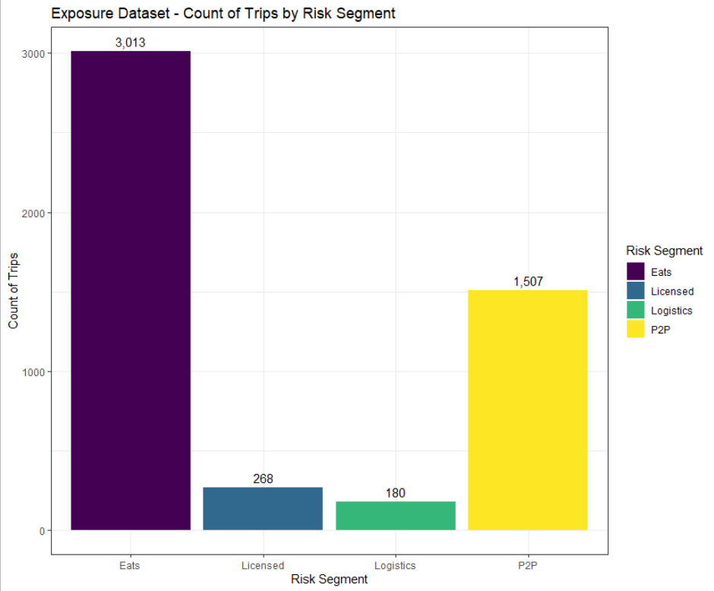
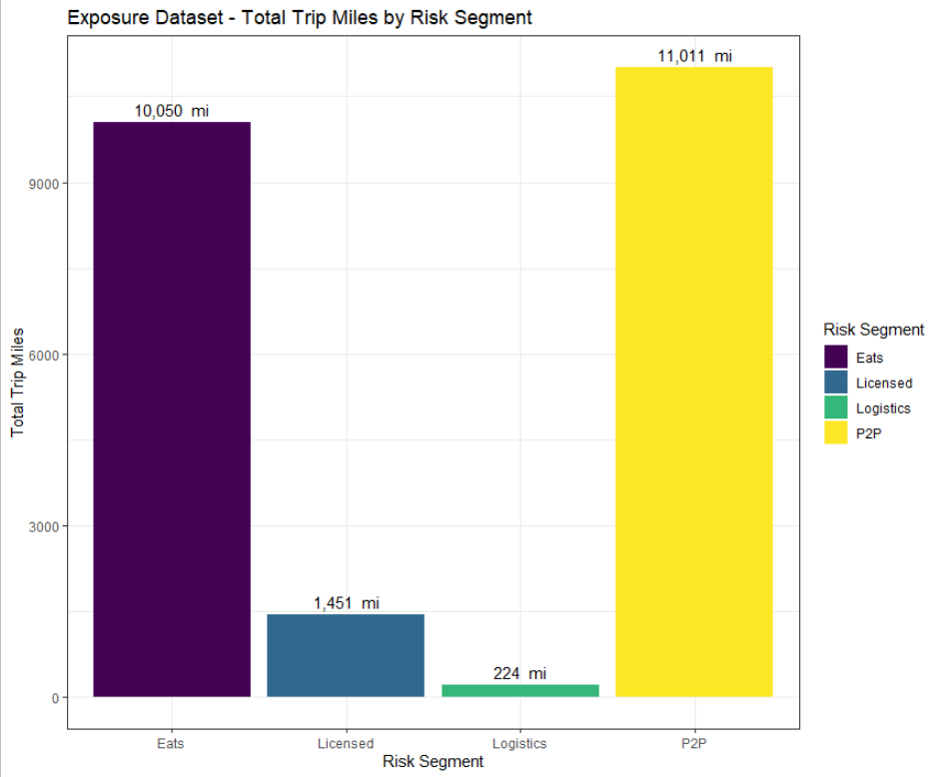
Dataset 3 – Trip & Driver Information
Exploratory Data Analysis: Understanding Risk Segment
Exposure Dataset covers pandemic period, during which Eats delivers were probably more common
Despite fewer trips than Eats, P2P has more total trip miles due to a higher average Trip Distance, and a longer tail (see next slide)
Notes:
P2P trips also have a longer tail, which ultimately contribute to the greater amount of total miles driven

Slide 18
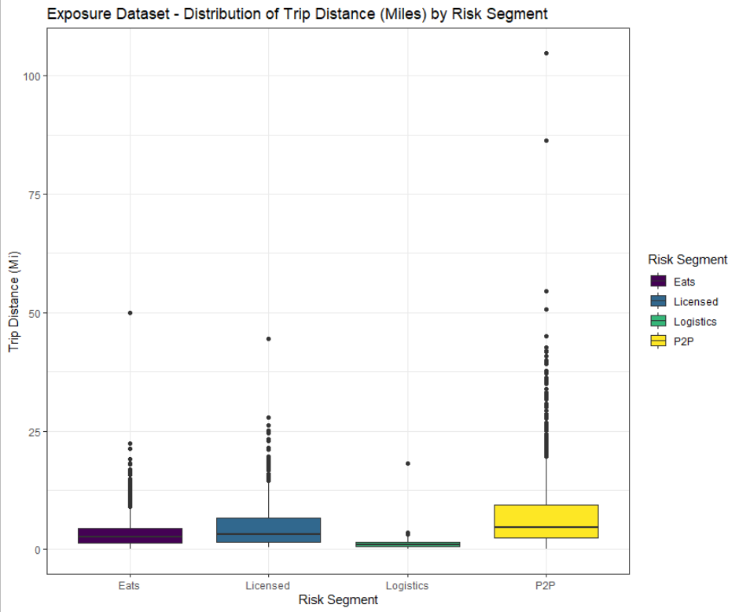
Dataset 3 – Trip & Driver Information
Exploratory Data Analysis: Distribution of Potential Exposure Bases

Slide 19
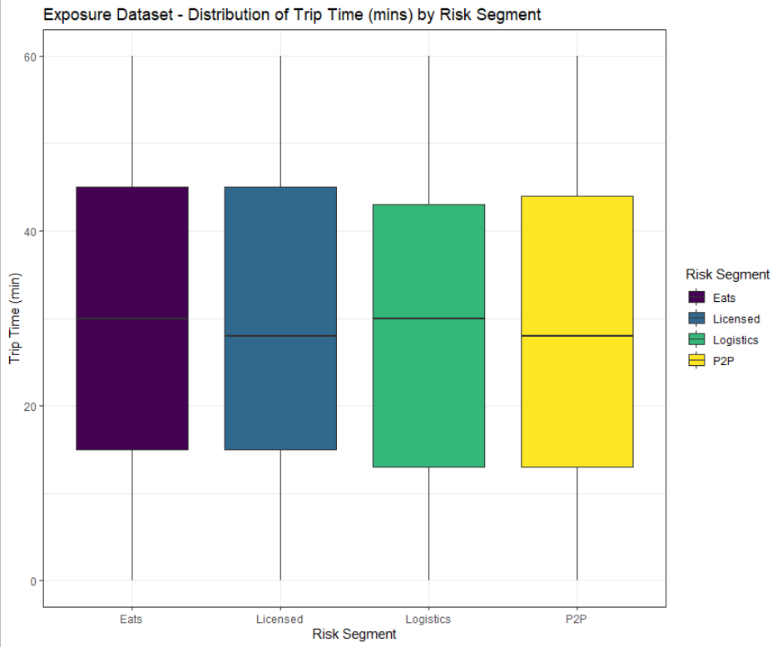
Dataset 3 – Trip & Driver Information
Exploratory Data Analysis: Distribution of Potential Exposure Bases

Slide 20
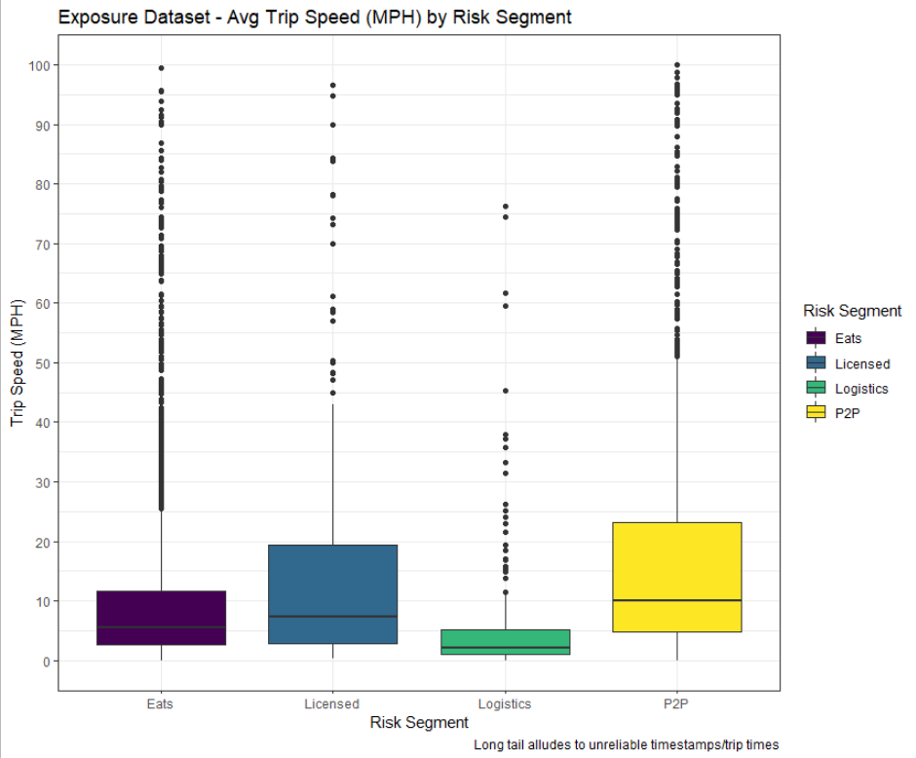
Dataset 3 – Trip & Driver Information
Exploratory Data Analysis: Distribution of Potential Exposure Bases

Slide 21
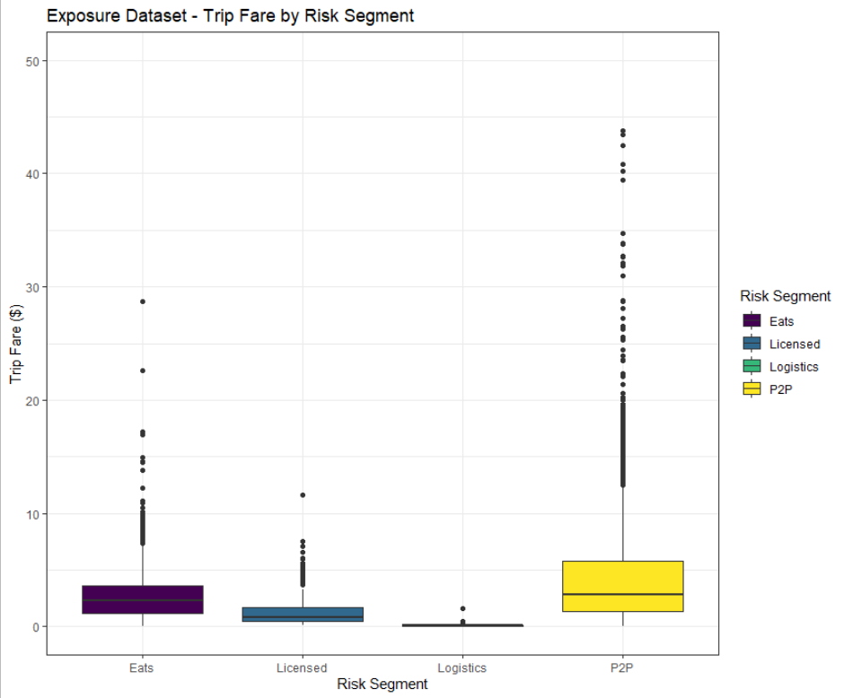
Dataset 3 – Trip & Driver Information
Exploratory Data Analysis: Distribution of Potential Exposure Bases

Slide 22
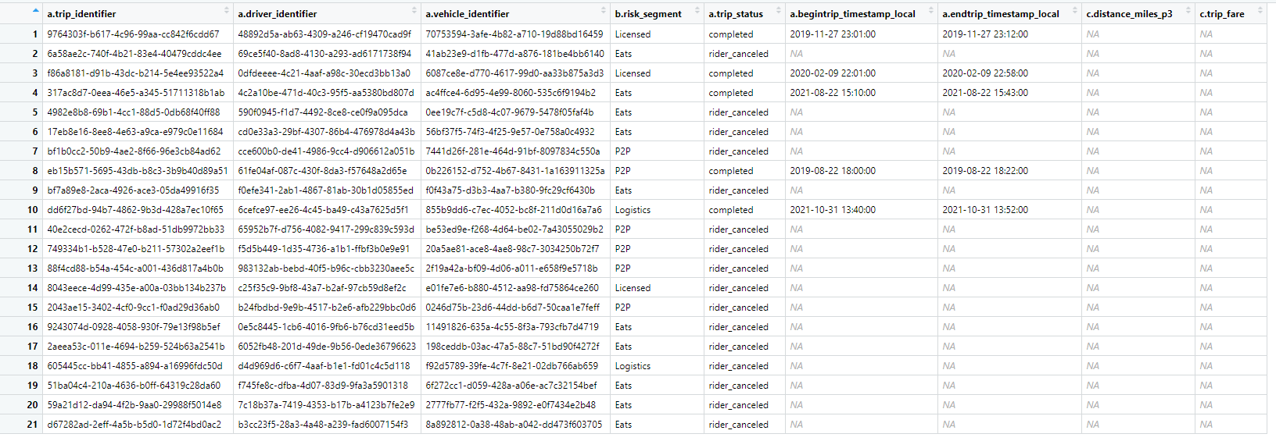
Dataset 3 – Trip & Driver Information
Data Cleaning and Adjustments - NAs
NA information primarily corresponds to cancelled trips
Data is unusable for exposure purposes anyways - deleted

Slide 23
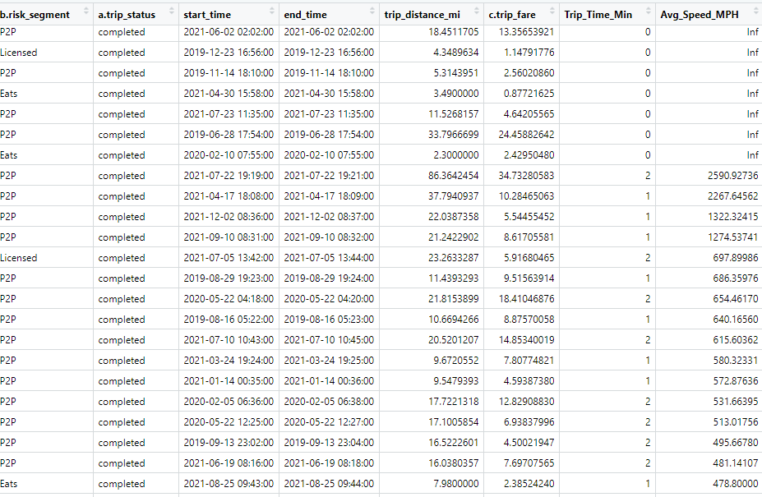
Dataset 3 – Trip & Driver Information
Data Cleaning and Adjustments - Trip Time
Observe unreasonably short trip times for some rows, e.g. trip times of 0 minutes
Since trip distance will most likely be used as the selected Exposure Base, and distance values appear reasonable (esp. in relation to trip fare), these rows were not removed

Slide 24
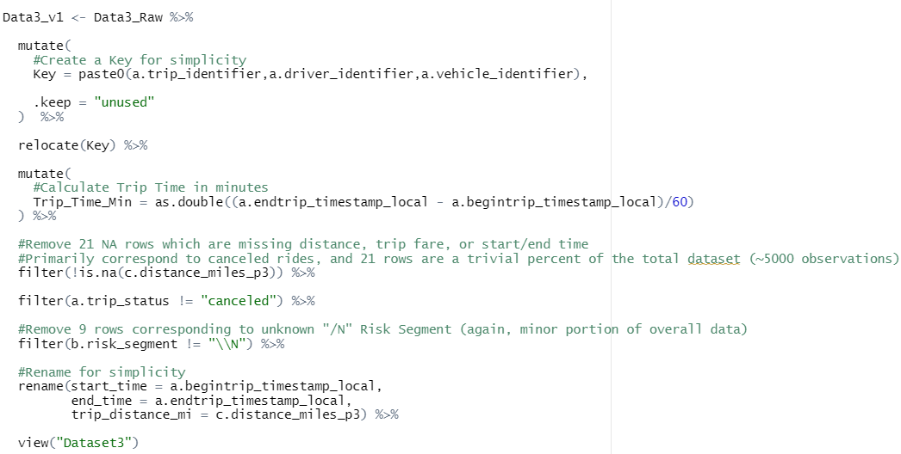
Dataset 3 – Trip & Driver Information
Data Cleaning and Adjustments

Slide 25
Dataset 3 – Trip & Driver Information
Clarifying Questions
Why does the exposure data (Dataset 3)’s dates not correspond to the loss data (Datasets 1 and 2)?
Exposure Data: 2019Q2 – 2022Q1
Loss Data: 2018Q1 – 2021Q4
2018Q1 – 2019Q1 Exposures are missing!
Based on a.trip_identifier, would it be possible to also provide the number of passengers on the trip? (Has value as a potential exposure base)
How is distance calculated? Is it actual distance travelled, or geodesic distance?
Is trip fare all in the same currency? Has there been any inflationary (or other) adjustments applied?
During which period does trip time and trip distance begin? Does it begin with P2 or P3?
If it begins with P2, is there data which splits out trip time and distance by period?
Is it possible for riders to cancel mid-trip? If so, that data should be included as well if possible/available, since there is still risk exposure during the partial trip.
What exposure base is the reinsurer using for their analysis? Should our analysis align with theirs?

Slide 26
Exposure Base
Criteria for Exposure Bases
Proportional to Expected Loss The exposure base chosen should be directly proportional to expected loss
Practical The selected base should be objective and relatively easy and inexpensive to obtain and verify
Historical Precedence Any change in an exposure base should be very carefully considered prior to implementation for several reasons
Werner & Modlin – Chapter 4: Exposures
For purposes of this exercise, the focus will be on criteria 1 & 2 since there is limited historical precedence

Slide 27
Exposure Base
Ideal BI Liability Exposure Base
Passenger Miles Traveled = (# Passengers) x (# Trip Miles)
Explanation:
# Passengers: The # Passengers in a vehicle will be directly correlated with the number of injuries (and thus ultimate severity of the total BI claim) in an accident
# Trip Miles: The more miles travelled, the more like a driver is to eventually get into an accident (correlated with accident frequency)
Criteria:
Criteria 1: Proportional to Expected Losses - discussed above
Criteria 2: Practical – The above measures are tracked by Uber and therefore readily available. They are also objective measures
Unfortunately, the exposure dataset provided does not include # of Passengers, so we need to look for alternatives
Notes:
*Assume BI Liability coverage, since that was the coverage provided in Dataset 1

Slide 28

Exposure Base
Evaluating Potential BI Exposure Bases
 | # Trips Taken | Trip Fare | Trip Time | Trip Distance
Criteria 1: Proportional to Expected Loss
Criteria 2: Practical
*Assumes all exposure bases would be aggregated to annual/monthly level
Notes:
Since we are unable to directly assess correlation between losses and each exposure base, we must qualitatively evaluate each exposure base

Slide 29
Exposure Base
Potential Exposure Base 1: # Trips Taken
Criteria:
Criteria 1: Proportional to Expected Losses - Risk increases in proportion to the number of trips taken
Criteria 2: Practical – Tracked by Uber and therefore readily available. # Trips Taken is an objective measure
Additional Comments:
Benefit is in its simplicity and ease of use
A decent measure of risk but does not capture more granular trip details (e.g. longer trips vs shorter trips)
Trip Distance or Trip Time will probably be more correlated with Expected Losses

Slide 30
Exposure Base
Potential Exposure Base 2: # Trip Fare
Criteria:
Criteria 1: Proportional to Expected Losses - Correlated with Trip Distance/Time, which is correlated with expected losses
Criteria 2: Practical – Tracked by Uber and therefore readily available. Trip Fare is an objective measure
Additional Comments:
Other factors influence Trip Fare that would likely weaken its correlation with expected losses,
E.g. Supply/Demand of riders/drivers, time of day, location, fuel prices, type of Uber ride, etc.
Has the benefit of incorporating (to some extent) # of passengers, which is related to expected BI losses
Inflationary Exposure Base – source of additional uncertainty in future calculations

Slide 31
Exposure Base
Potential Exposure Base 3: Trip Time
Criteria:
Criteria 1: Proportional to Expected Losses - Risk increases in proportion to the time of the trip
Criteria 2: Practical – Tracked by Uber and therefore readily available. Easily subject to driver manipulation
Additional Comments:
A direct function of trip distance, but also influenced by other factors (e.g. idling/waiting, driving faster/slower, traffic,…)
Some concerns over data accuracy of trip timestamps
Subject to Moral Hazard – A driver could be incentivized to manipulate the time of the ride if it affects their insurance premiums (e.g. idling longer)

Slide 32
Exposure Base
Potential Exposure Base 4: Trip Distance
Criteria:
Criteria 1: Proportional to Expected Losses - Risk increases in proportion to the miles travelled
Criteria 2: Practical – Tracked by Uber and therefore readily available. Trip Distance is an objective measure
Additional Comments:
Most directly proportional to BI Expected Losses (hypothesizing) since least distorted by other non-risk factors
Measures in place to reduce Moral Hazard (e.g. rider can request a refund if a driver intentionally takes a longer route)
Notes:
Non-Risk Factors e.g. Trip Fare affected by Supply/Demand of drivers and Riders, or Trip Time affected by idling/waiting time

Slide 33
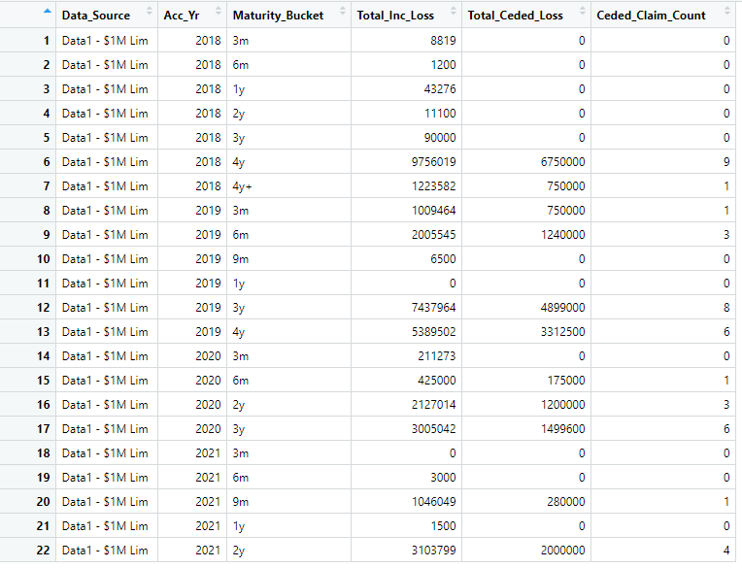
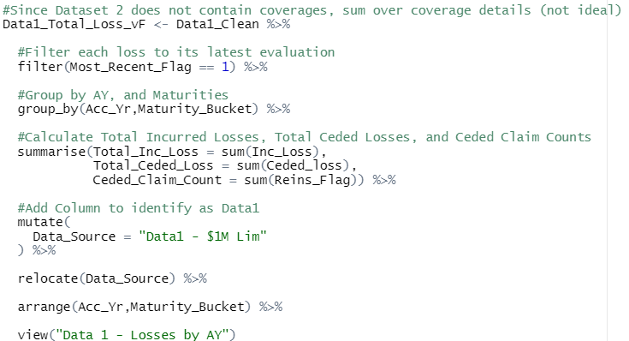
Calculating Ceded LC and Frequency
Preparing Loss Data – Dataset 1
*Maturities were bucketed into: 3m, 6m, 9m, 1y, 2y, 3y, 4y, 4y+
** Interpreting prompt as determining the latest diagonal of a loss triangle only, therefore only looking at latest evaluation dates
Notes:
#Note - Interpreting prompt as determining the latest diagonal of a loss triangle only
#Therefore only looking at latest evaluation dates

Slide 34
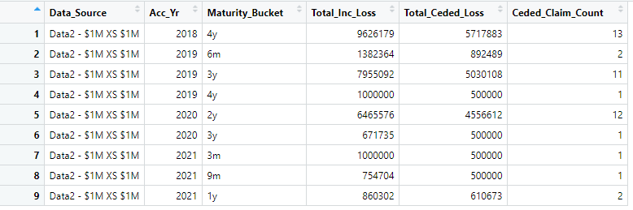
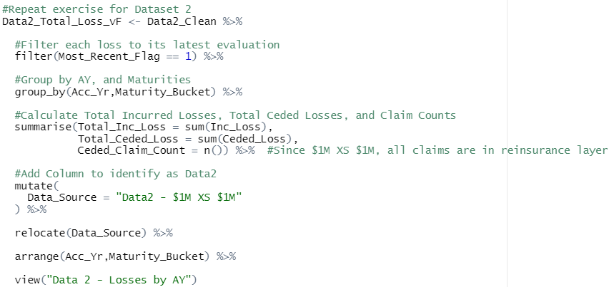
Calculating Ceded LC and Frequency
Preparing Loss Data – Dataset 2
*Maturities were bucketed into: 3m, 6m, 9m, 1y, 2y, 3y, 4y, 4y+
** Interpreting prompt as determining the latest diagonal of a loss triangle only, therefore only looking at latest evaluation dates
Notes:
#Note - Interpreting prompt as determining the last diagonal of a loss triangle only
#Therefore only looking at latest evaluation dates

Slide 35
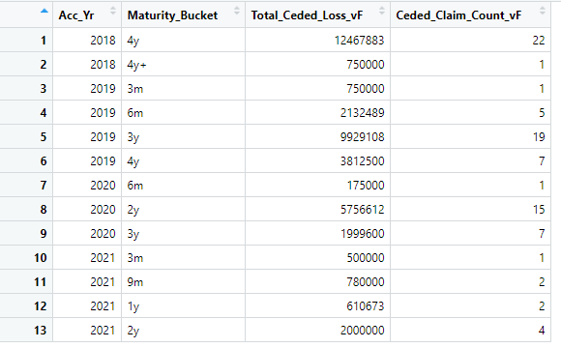
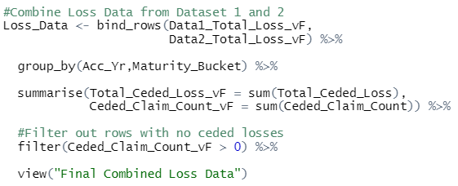
Calculating Ceded LC and Frequency
Preparing Loss Data – Combining Dataset 1 & 2
*Maturities were bucketed into: 3m, 6m, 9m, 1y, 2y, 3y, 4y, 4y+
** Interpreting prompt as determining the latest diagonal of a loss triangle only, therefore only looking at latest evaluation dates

Slide 36
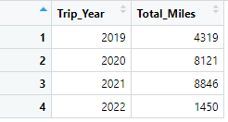
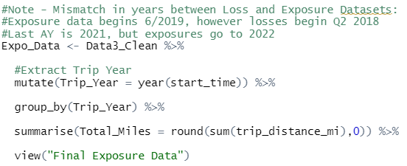
Calculating Ceded LC and Frequency
Preparing Exposure Data – Dataset 3

Slide 37
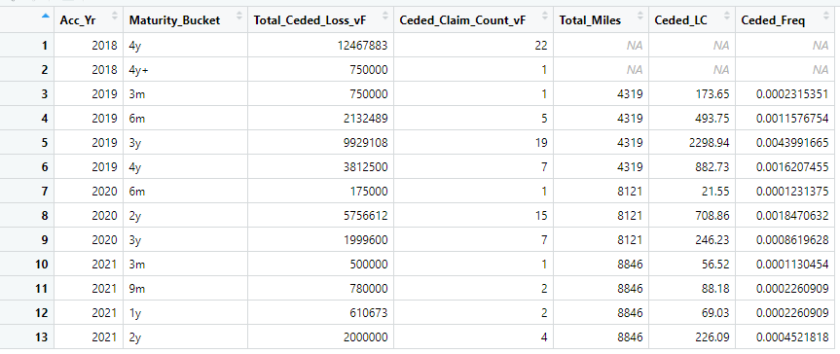
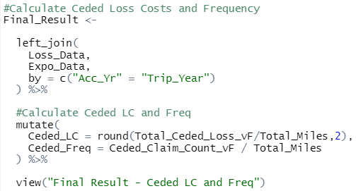
Calculating Ceded LC and Frequency
Final Calculation

Slide 38
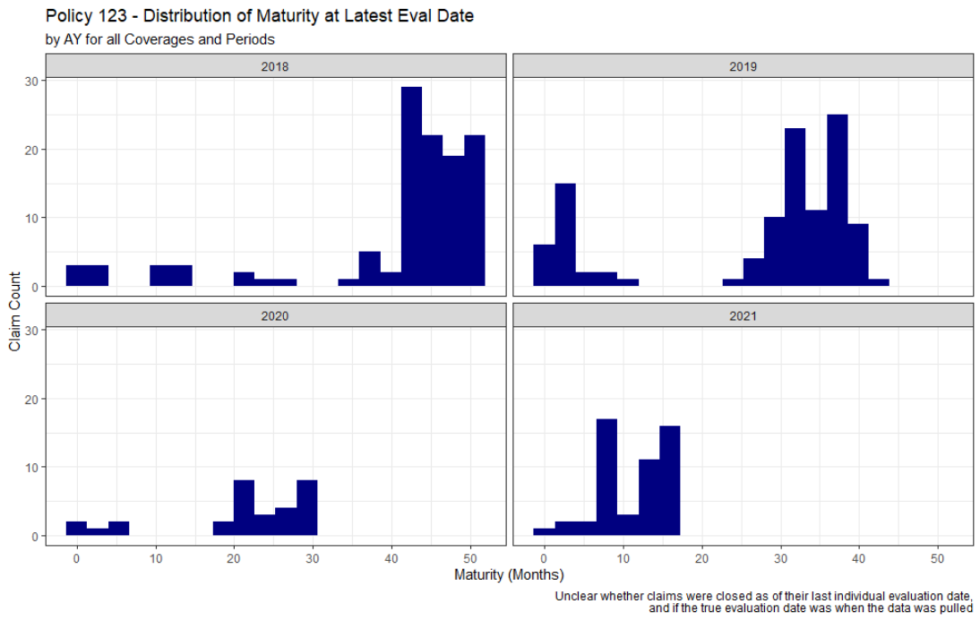
Calculating Ceded LC and Frequency
Calculation Concerns regarding Maturity
Typically when developing a Loss Triangle, all losses share the same (final) evaluation date – this means all losses from a given AY are at the same maturity
However, the last evaluation date on the loss data provided varies by claim, meaning not all claims are at the same maturity e.g. AY 2018 maturities range from < 10 months to 50+ months
This results in ambiguous loss triangles, where individual cells may not contain the full AYs loss experience
These loss triangles will be of limited use

Slide 39
Calculating Ceded LC and Frequency
Revised Assumption regarding Maturity
Assume a “true” evaluation date of 6/30/2022 (when the data was presumably pulled)
Based on the shared maximum evaluation date from Data 1 and Data 2
Under this assumption, all claims are at the same maturity (evaluated 6/30/2022), despite their individual evaluation dates
Assuming uniform loss experience over the year, the average accident date would be 6/30, implying
AY 2018 at 4 years of maturity
AY 2019 at 3 years of maturity
Etc.

Slide 40
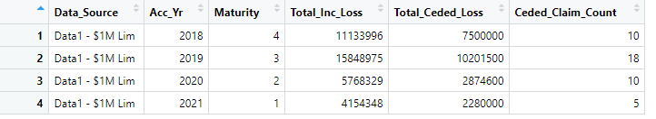
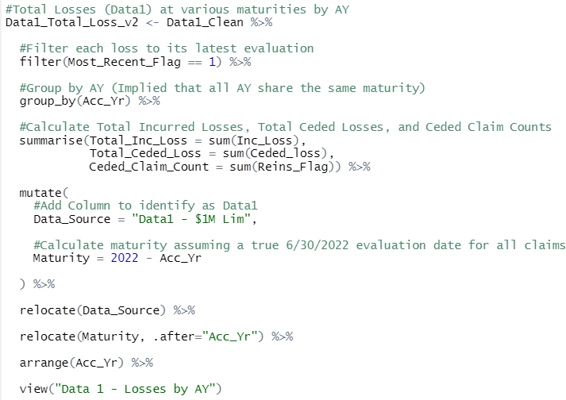
Calculating Ceded LC and Frequency
Preparing Loss Data – Dataset 1 (version 2)

Slide 41
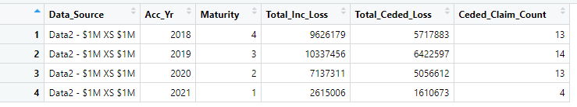
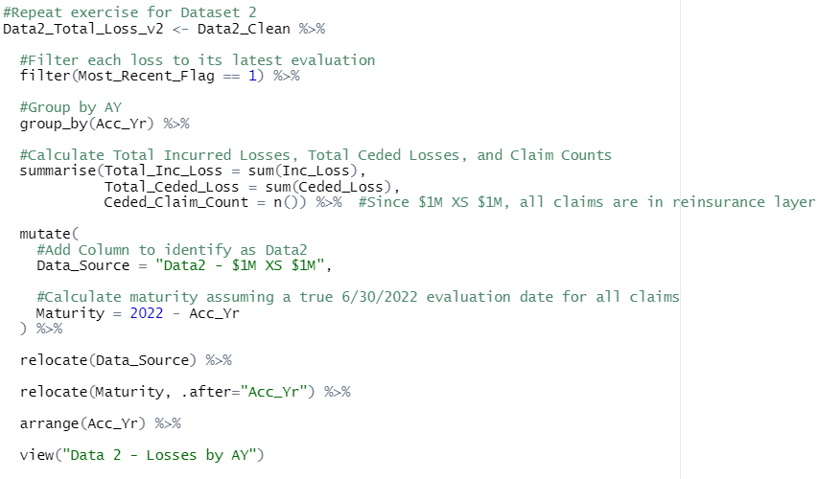
Calculating Ceded LC and Frequency
Preparing Loss Data – Dataset 2 (version 2)

Slide 42
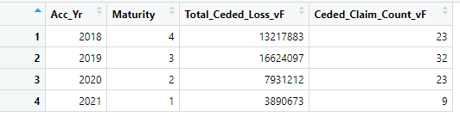
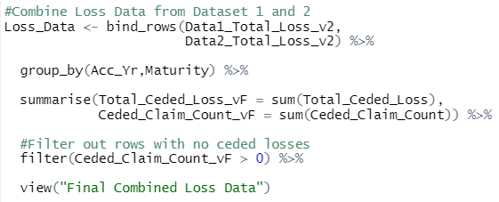
Calculating Ceded LC and Frequency
Preparing Loss Data – Combining Dataset 1 & 2 (version 2)

Slide 43
Calculating Ceded LC and Frequency
Preparing Exposure Data – Dataset 3 (version 2 - unchanged)

Slide 44
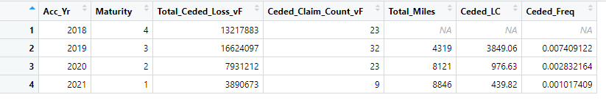
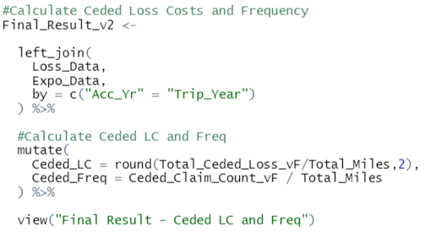
Calculating Ceded LC and Frequency
Final Calculation – version 2

Slide 45
Conclusion
Initial analysis suggests value in pursuing the reinsurance contract due to the high potential severity of BI claims

Slide 46
Topics for Further Research
Loss Development
Loss Trend
COVID-19 Data Adjustments
Seasonality

